Slide 1
Portuguese Bank Marketing Case Study
ANÀLISI DE DADES I EXPLOTACIÓ DE LA INFORMACIÓ
Sergio Delgado Ampudia
Fujie Mei
Mario Wang

Slide 2
Índex
Introduction
Data Description, Processing, Validation and Profiling
PCA
Hierarchical clustering from MCA
CA & Clustering
Linear regression: model construction
Logistic regression: model construction

Slide 3
Introduction
The course project is concerned with Multivariant Data Analysis and model building for response variables for recollected data of the outcome of a marketing campaign performed by a portuguese bank.
The objective of the project is to:
Predict how much probability you have to be successful given some socioeconomics characteristics. (binary outcome)
Predict the duration of the calls. ((Numeric Target)
We started with a random balanced sample containing 5.000 registers from a 40.000 registers dataset.

Slide 4
Data Description
5.000 rows and 21 columns (variables)
11 qualitative variables
10 quantitative variables
Numeric target = variable “duration”
Categorical target = variable “y”

Slide 5
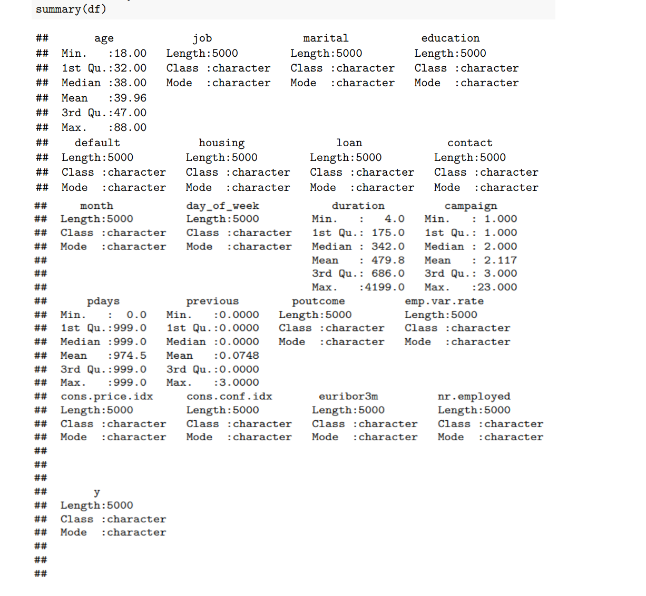
Data
Description

Slide 6
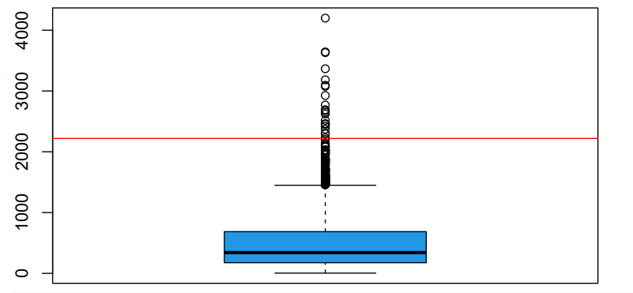
QUANTITATIVE VARIABLES
-We have analyzed each quantitative variable using boxplots
-We have detected:
Missings
Errors
Outliers

Slide 7
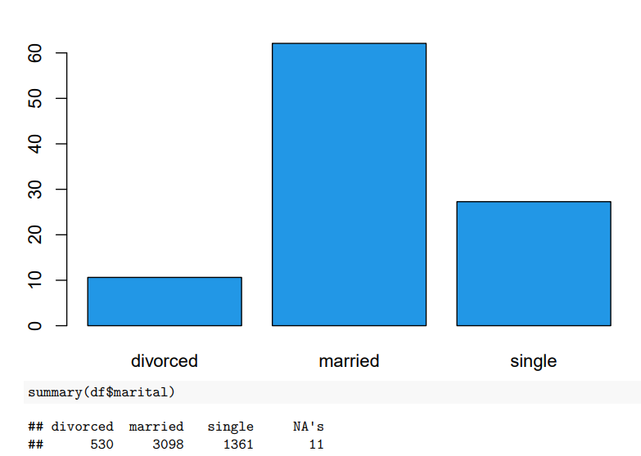
QUALITATIVE VARIABLES
-We have analyzed each qualitative variable using barplots
-We have detected:
Missings (NA’s)
Errors

Slide 8
IMPUTATION
After detecting all NA’s, now we have to impute them with imputePCA for numeric variables and imputeMCA for categorical variables

Slide 9

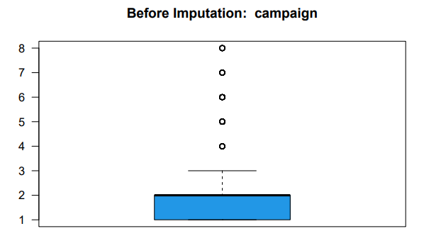
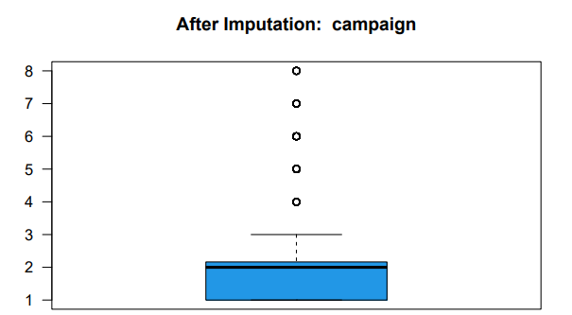
ImputePCA

Slide 10

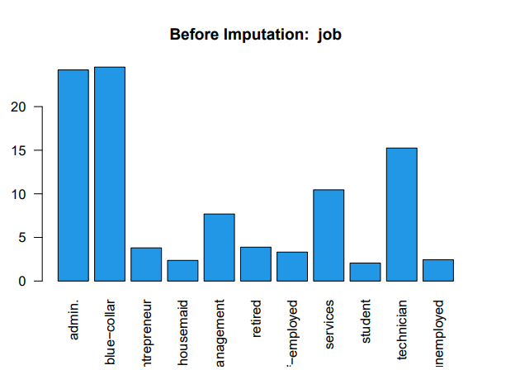
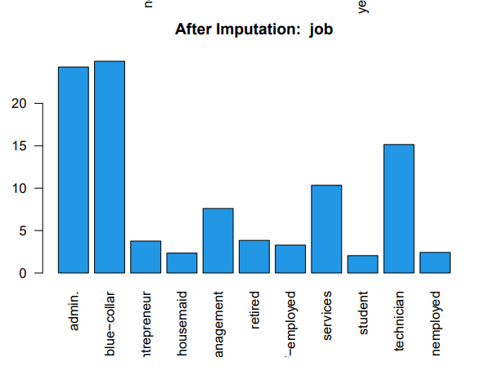
ImputeMCA

Slide 11
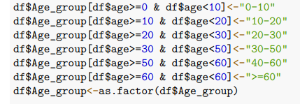
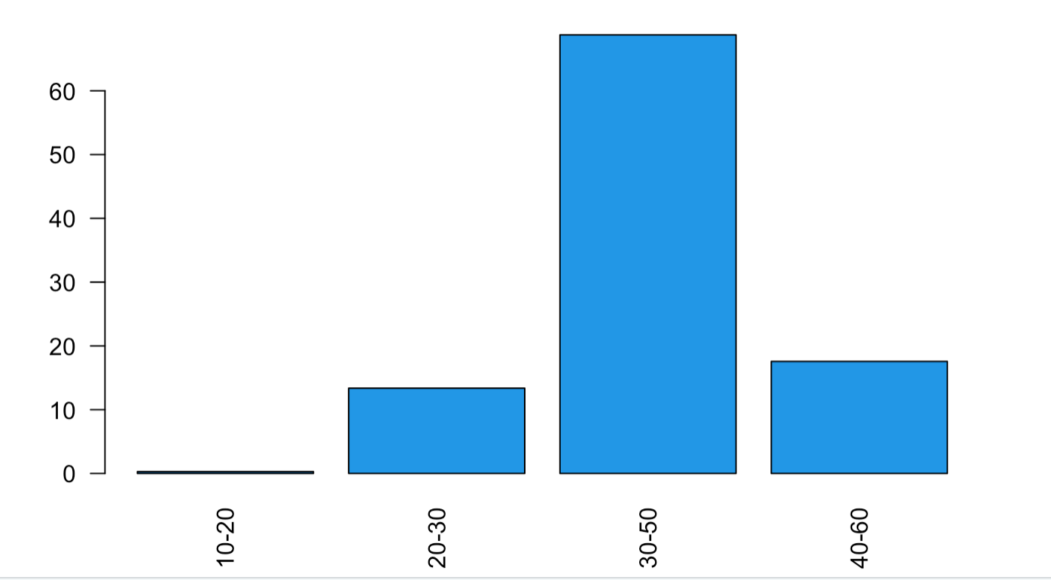
DISCRETIZATION
Discretization of numeric variables
Turning different rangs of variables into factors to get the data sorted

Slide 12
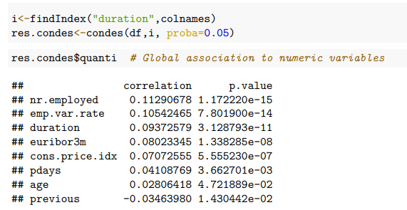
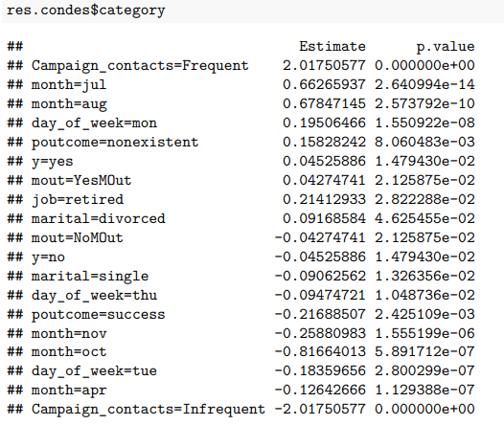
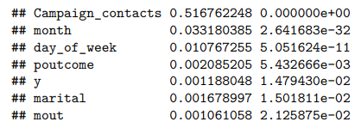
PROFILING target duration

Slide 13
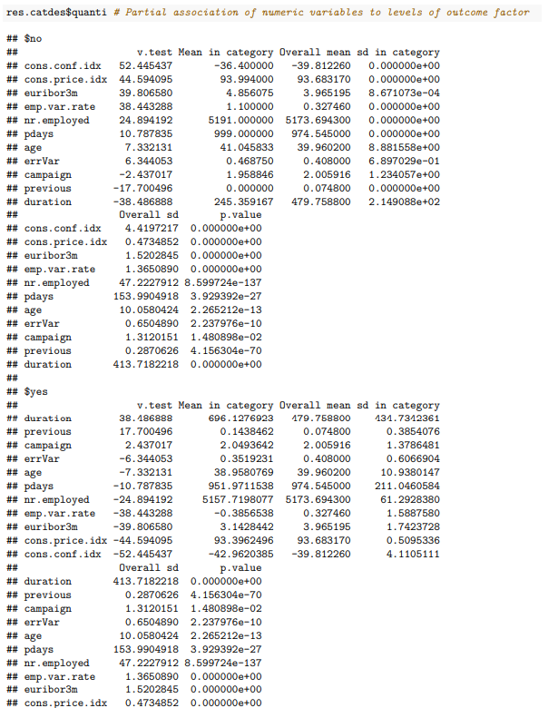
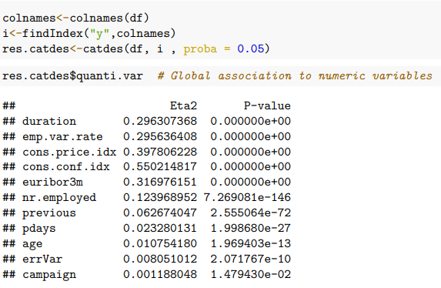
PROFILING target y

Slide 14
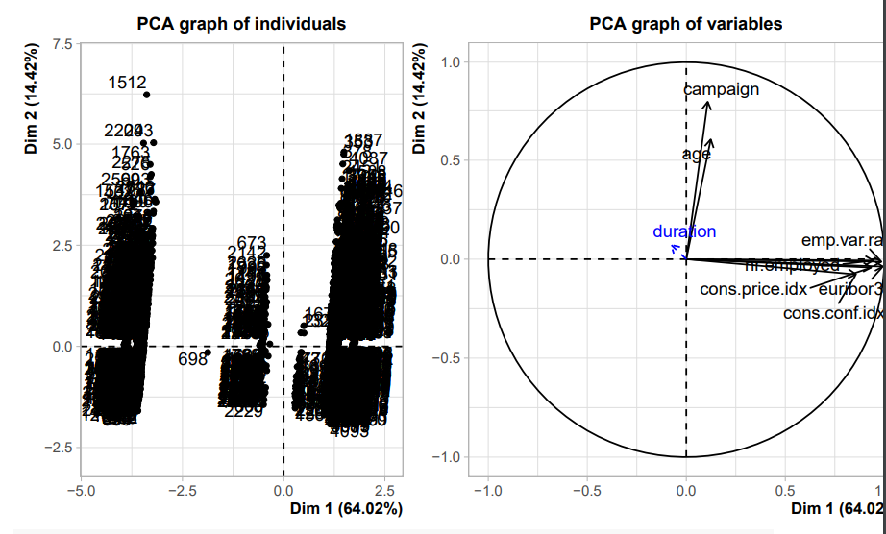
PCA

Slide 15
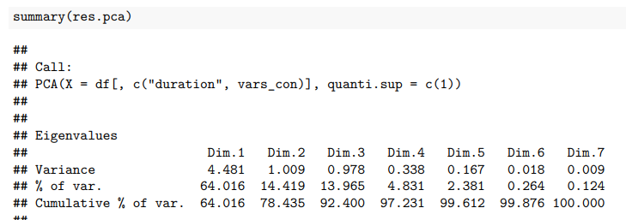
Kaiser Criteria
We should consider 2 dimensions. In our case, we will take Kayser’s rule into consideration because it’s the least number of components and the cumulative variation is almost 80%.

Slide 16
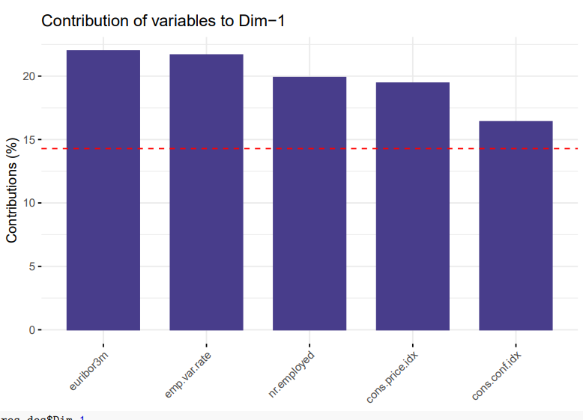
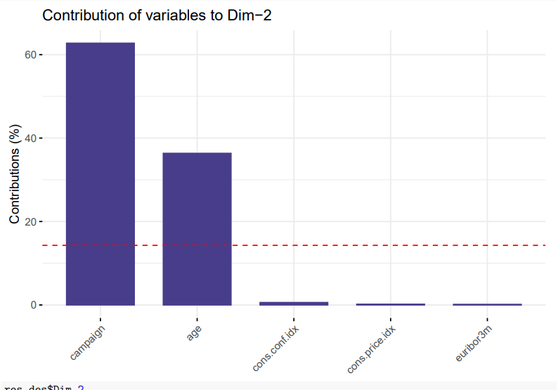

Slide 17
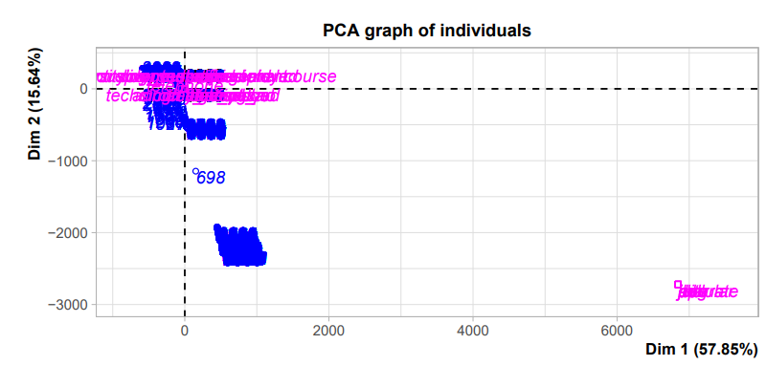
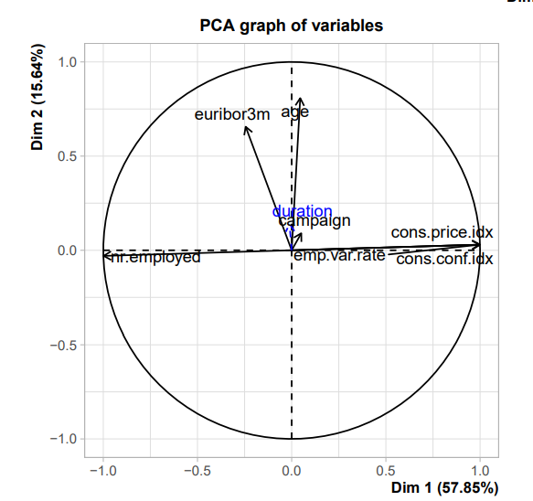
PCA taking into account also supplementary variables that can be quantitative and/or categorical

Slide 18

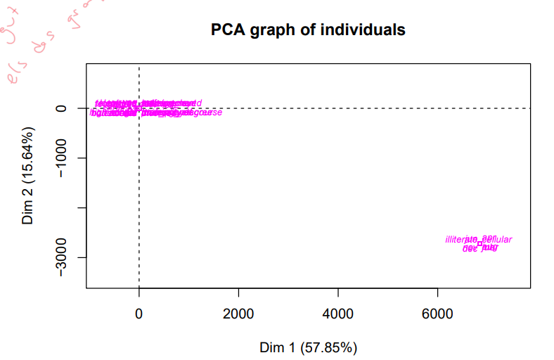

Slide 19
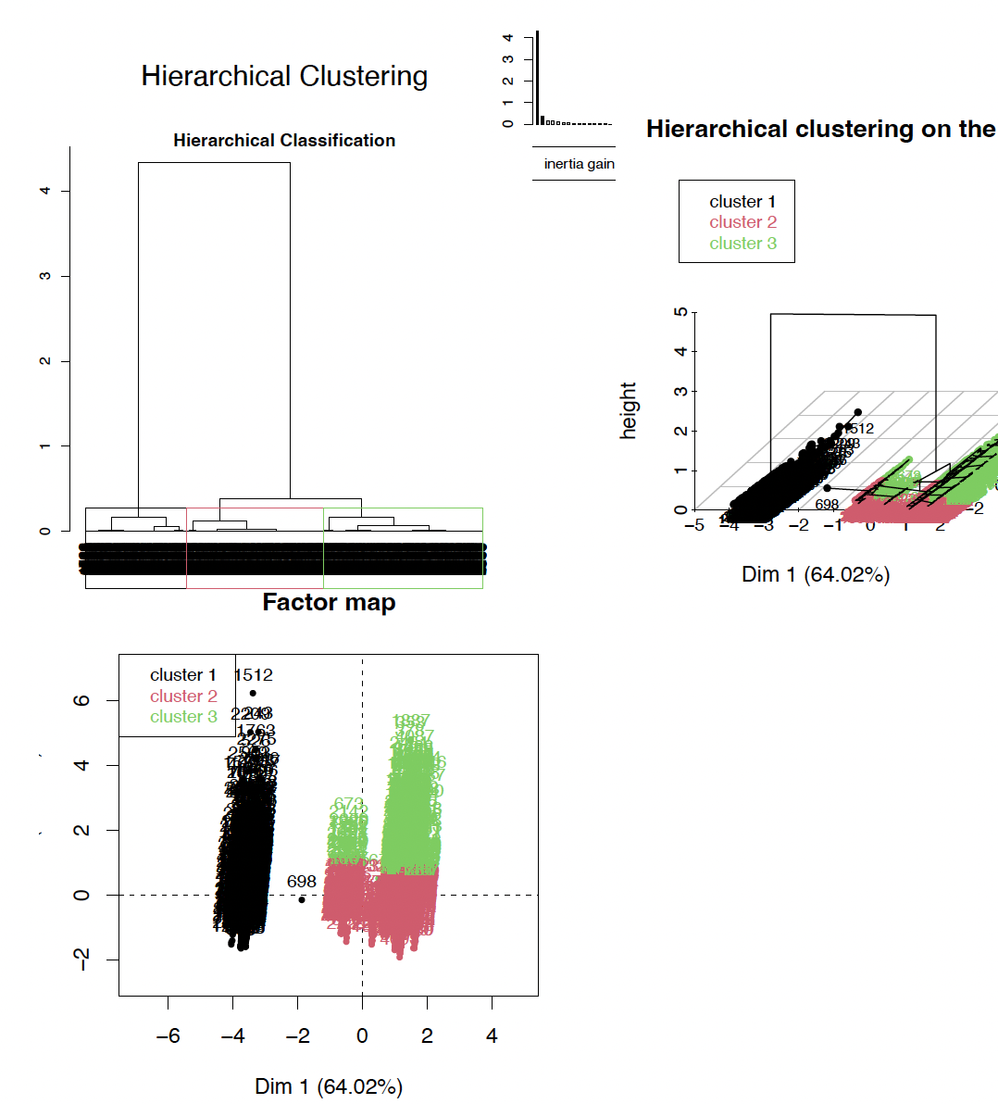
Hierarchical clustering
from MCA
• Cluster 1:
These are the people who will say yes.
contacted by cellulars.
Single university graduates.
• Cluster 2:
There are people who are more likely to say no
Contacted on November by
Divorced
• Cluster 3:
These are people who are married and retired, which will most likely say no.
Contacted by telephone.

Slide 20
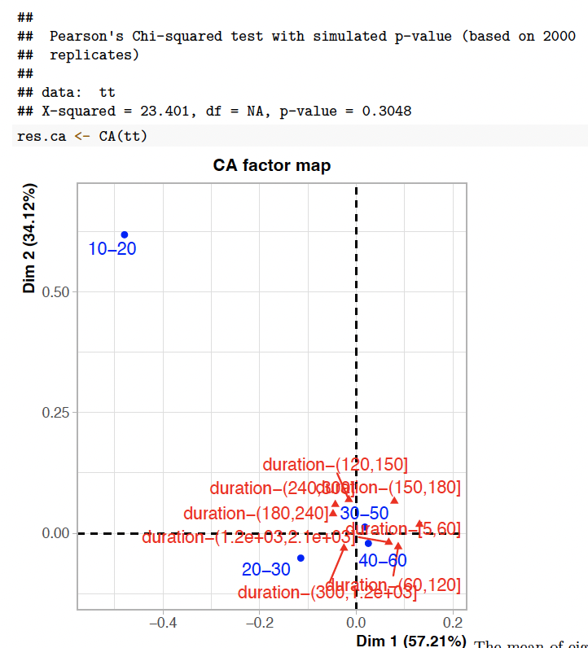
CA(Age group
vs f.duration)
The duration is independent of
the age group

Slide 21
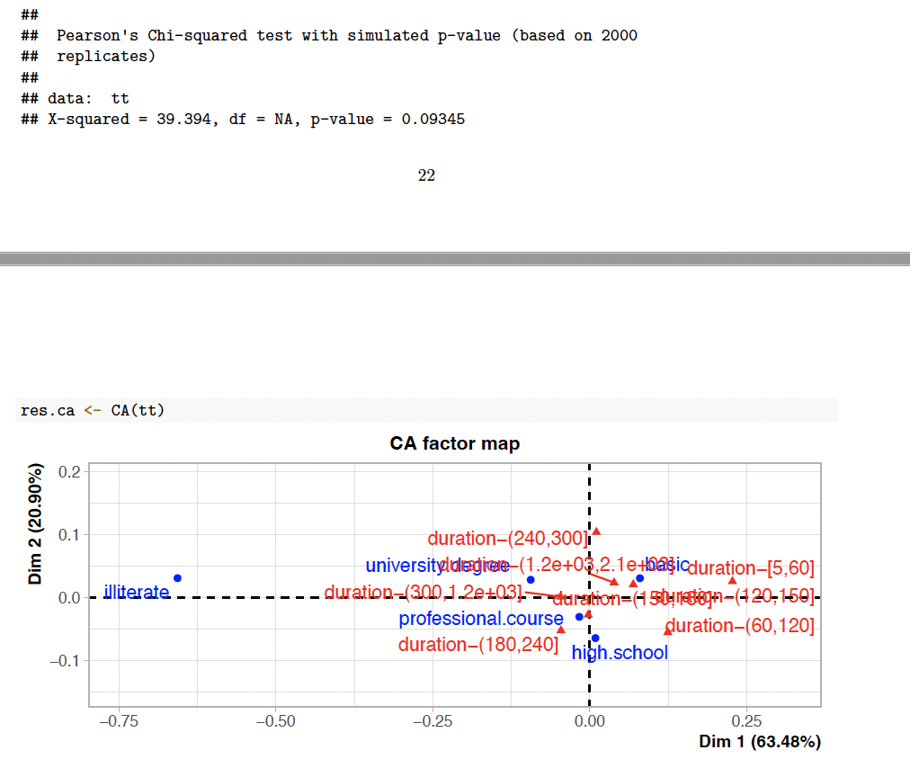
CA(Education
vs f.duration)
Education is
independent of the
duration

Slide 22
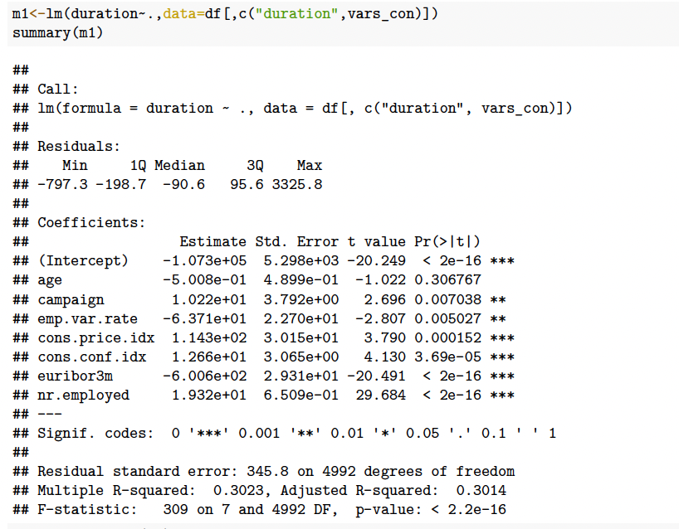
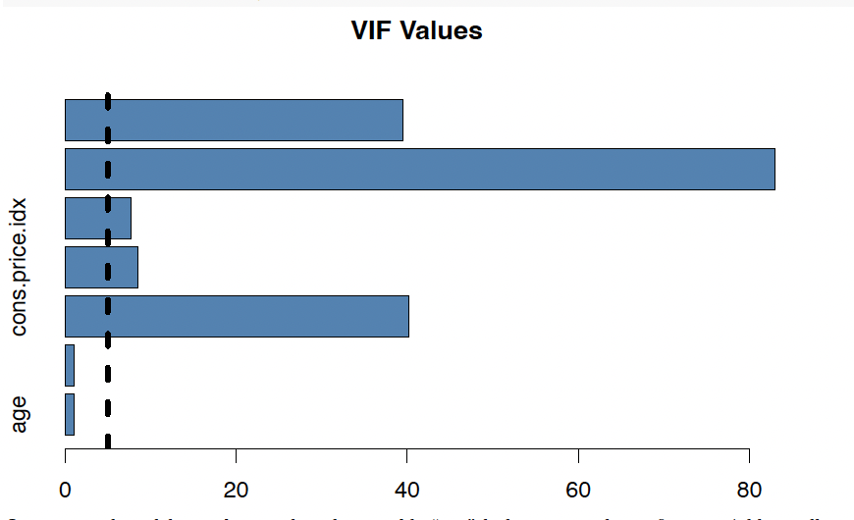
Linear regression: model construction
Initial model

Slide 23
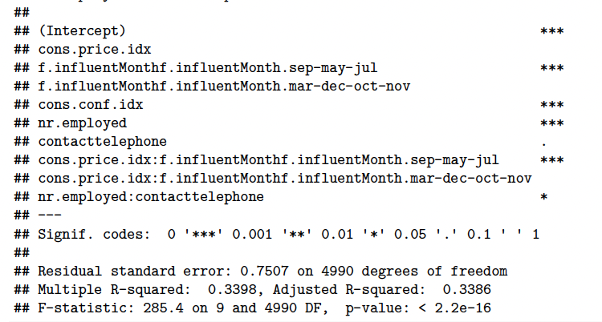
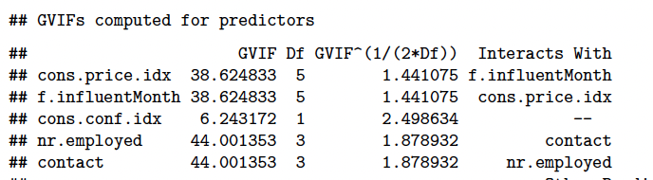
Linear regression: model construction
Final model

Slide 24
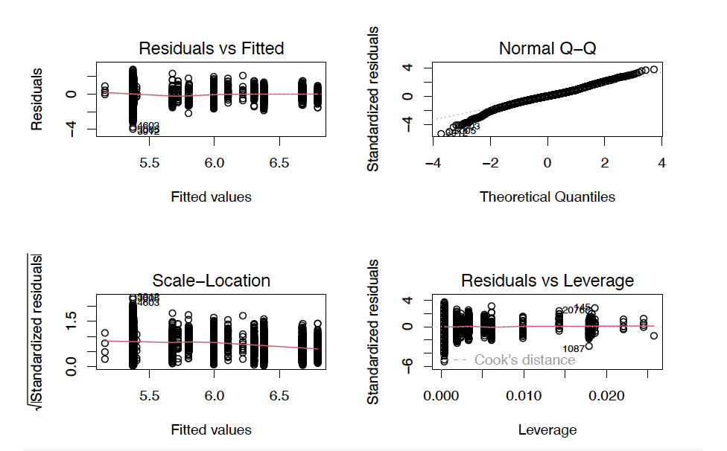
Validation

Slide 25
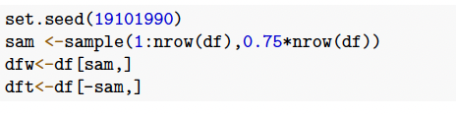
WORK AND TEST SAMPLES

Slide 26
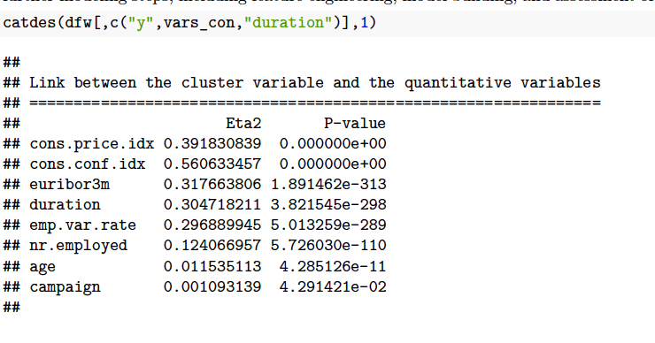
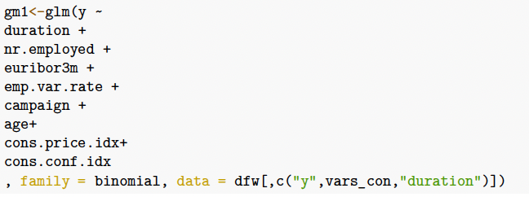
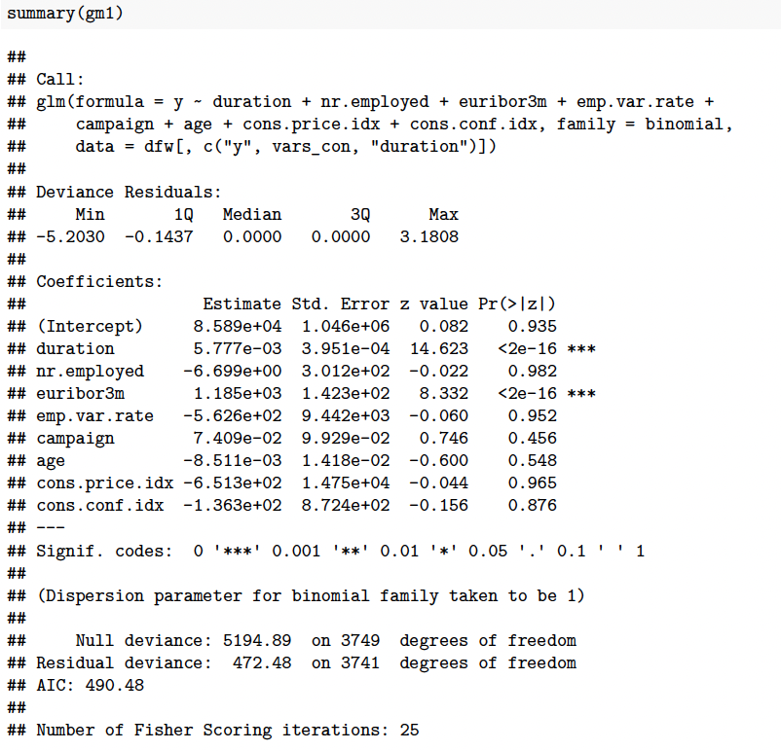
Logistic regression: model construction
Initial model

Slide 27
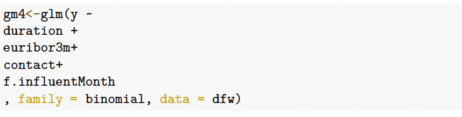
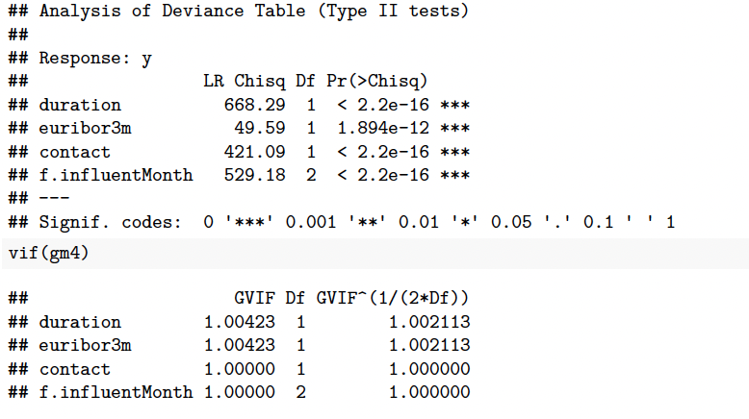
Logistic: model construction
Final model

Slide 28
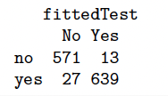
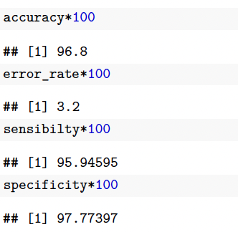
Predictions

Slide 29
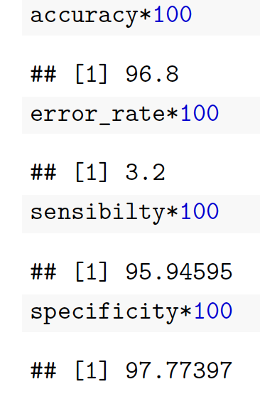
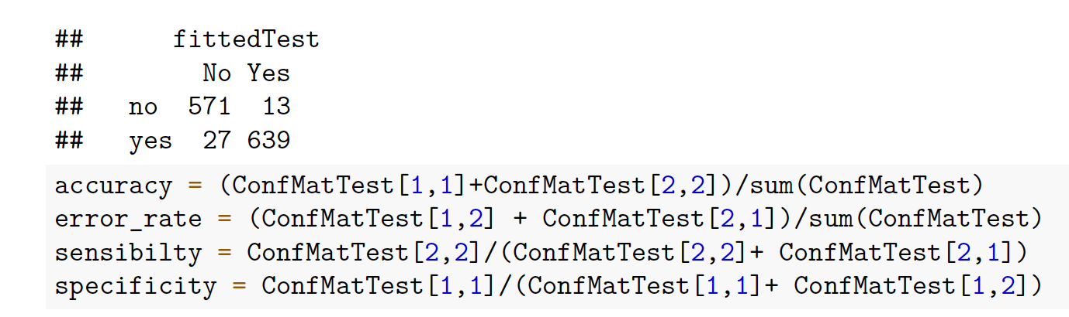
Predictions

Slide 30
Thanks for your attention

